Slide 1
Potential Retail Line Investment In Toronto and New York
10 Jun 2020

Slide 2
Background
New York City & City of Toronto
World busiest financial centres
Vast amount of opportunities for retail businesses
Problems Statement
Vast investment opportunities in retail lines
Resources limited, needs for increased probability of business success
Primary questions
What would be the top 5 retail shops in both Toronto and New York business districts?
If someone wants to setup a retail line in Toronto or New York, which retail line would be a safe bet given the current cluster of shops in these cities?

Slide 3
Data Requirements
Data Requirements
List & type of retail shops in Toronto & New York business districts
Ratings & reviews on type of popular retail lines in Toronto & New York
Trending data will be an added advantage
Data Preparation
Data Analysis Platform
Python Programming Language
Data Sources
New York City (URL : https://cocl.us/new_york_dataset)
Toronto (URL: https://en.wikipedia.org/wiki/List_of_postal_codes_of_Canada:_M)
Foursquare information on venues (URL : https://foursquare.com)

Slide 4
Exploratory Data Analysis / Modelling
Data Exploration & Analysis
Foursquare API
Explore Function
Python
Geopy Library
Folium Library
One-Hot Encoding
Clustering

Slide 5
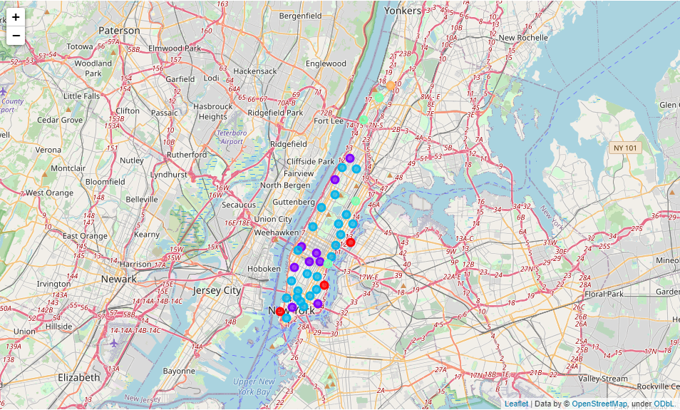
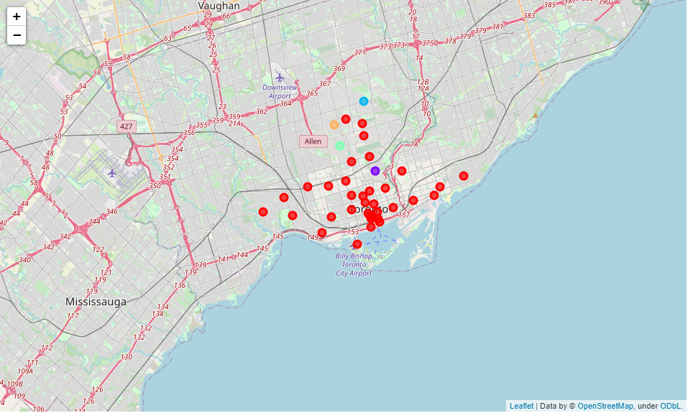
Results - Clustering
Map For Manhattan Showing Clusters
Map For Toronto Showing Clusters

Slide 6
Results – One-Hot Encoding
S/N | Manhattan Cluster
 | 0 | 1 | 2* | 3 | 4
1 | Park | Coffee Shop | Italian Restaurant | Mexican Restaurant | Sandwich Place
2 | Playground | Hotel | Coffee Shop | Café | Coffee Shop
3 | Coffee Shop | Café | Pizza Place | Bakery | Gym
4 | Farmers Market | Pizza Place | Café | Deli / Bodega | Yoga Studio
5 | Baseball Field | American Restaurant | Bar | Park | Supplement Shop
*Note : Top cluster with majority of neighbourhoods in the city
S/N | Toronto Cluster
 | 0* | 1 | 2 | 3 | 4
1 | Coffee Shop | Park | Park | Mexican Restaurant | Music Venue
2 | Café | Playground | Swim School | Jewelry Store | Ice Cream Shop
3 | Park | Trail | Bus Line | Trail | Garden
4 | Restaurant | Department Store | Yoga Studio | Sushi Restaurant | Dog Run
5 | Italian Restaurant | Event Space | Diner | Yoga Studio | Dessert Shop
*Note : Top cluster with majority of neighbourhoods in the city

Slide 7
Conclusion
High Similarities between Manhattan & Toronto
Majority of top categories in neighbourhoods
Eateries
Common top five categories in key clusters
Coffee Shop
Café
Italian Restaurant
Increased success probabilities with the identified categories

